Slide 1
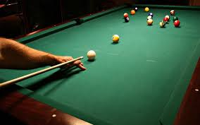
BILLIARDS MODELING AND SIMULATION
Armand sAlimnejad, Gabe freedman

Slide 2
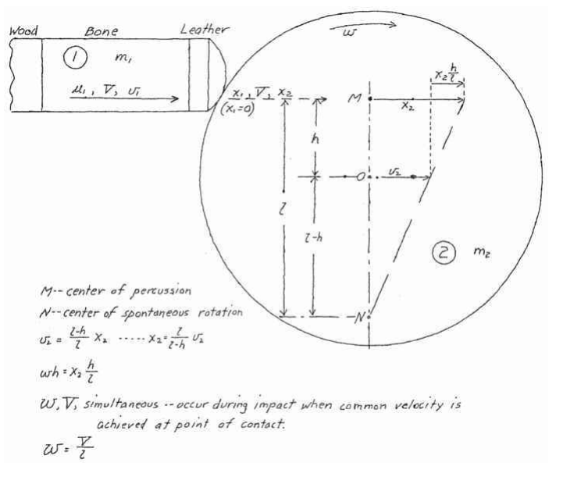
Problem
What are the equations of motion that describe a pool ball traveling across a table surface?
How are those equations different when the ball is subject to 3-dimensional spin?
How will the trajectories of two balls be affected if they collide with one another?
Where will the balls come to a stop on the table?

Slide 3
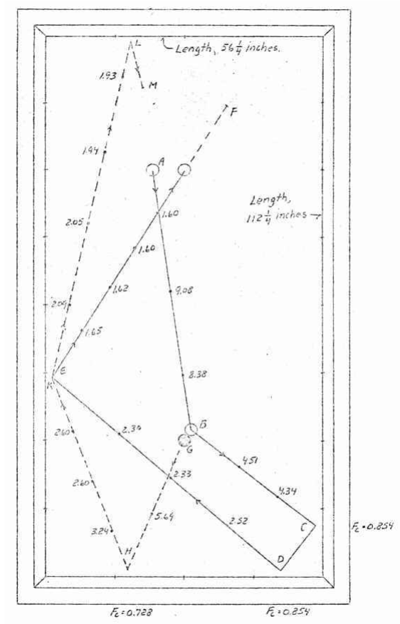
Goals
Accurately plot the trajectory of a pool ball subject to a set of initial conditions
Implement both sliding and rolling friction against the ball by the table surface
Allow the ball to have spin in all 3 dimensions
Track the collision of a ball with a wall of the table or another ball

Slide 4
The physics behind the problem
Conservation of momentum
Conservation of kinetic energy
Frictional forces both before and after slipping
Conservation of angular momentum in regards to spin

Slide 5
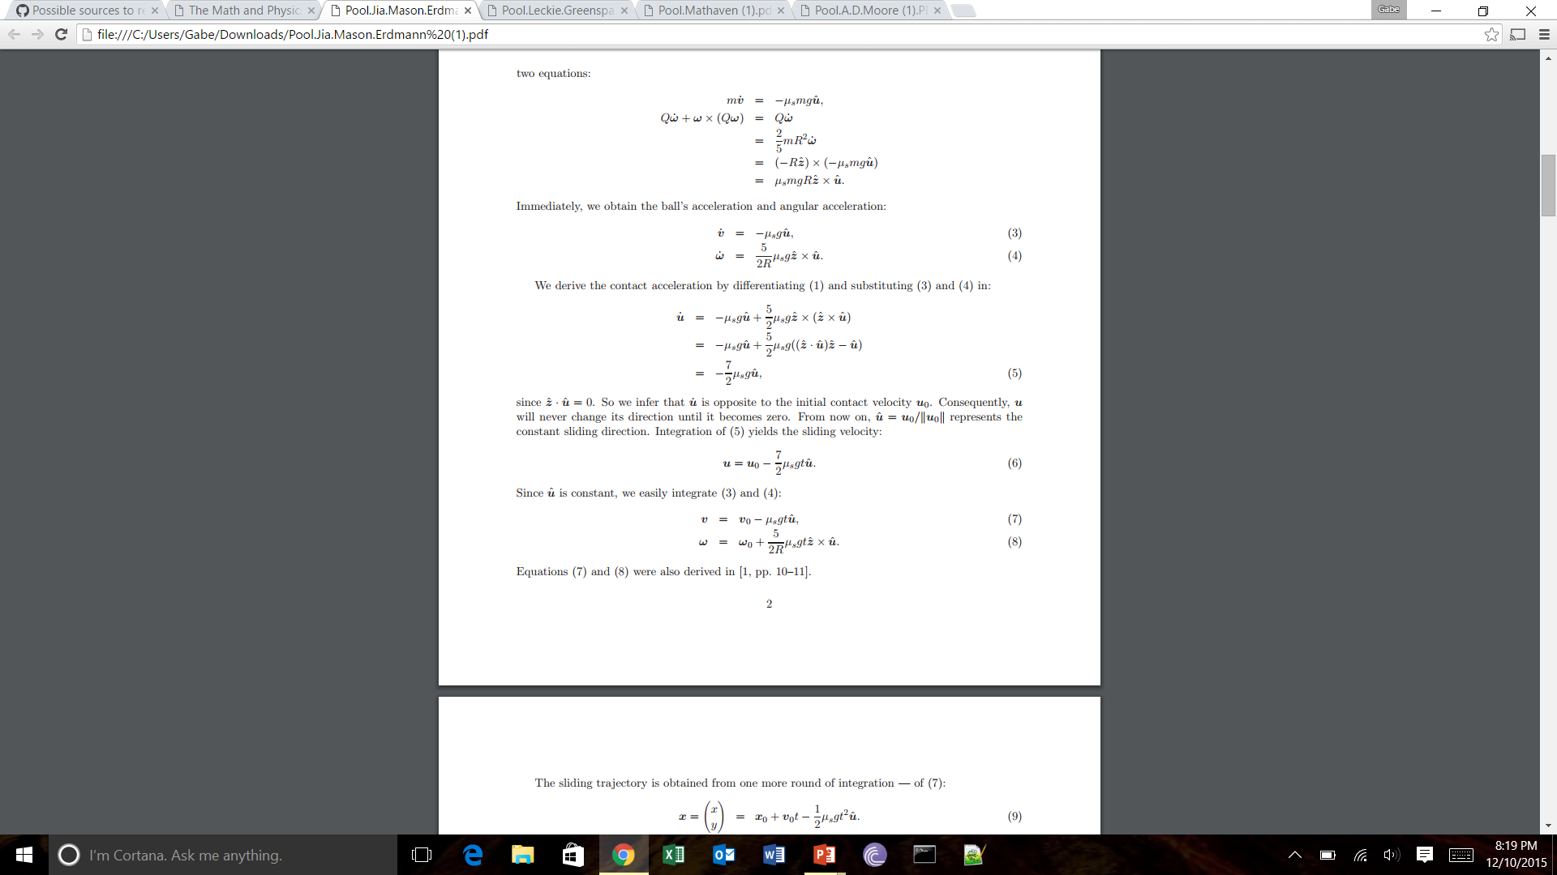
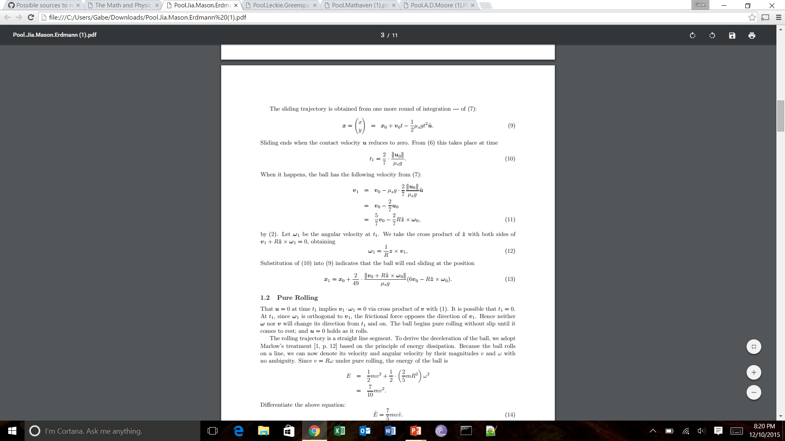
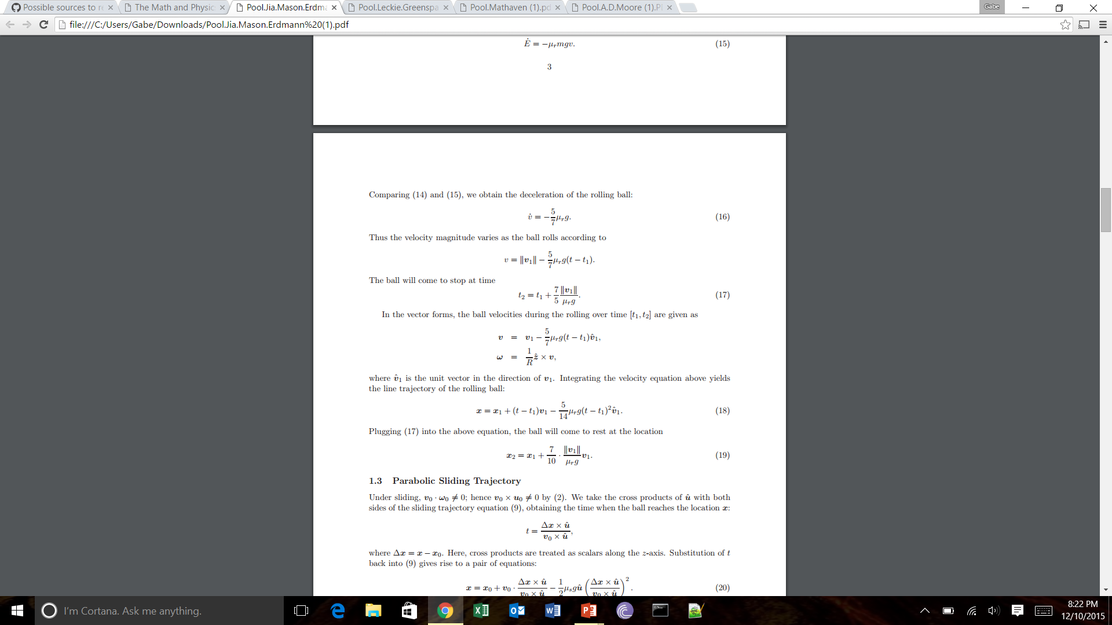
Sliding and rolling friction
First we work with the sliding velocity to determine the effect of sliding friction
We can find the position at which the ball stops sliding as well as the velocity of the ball at this point

Slide 6
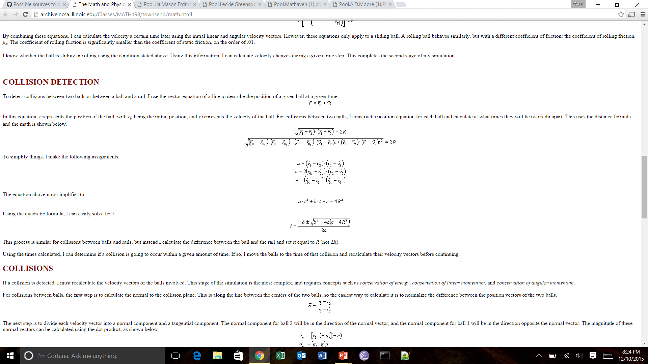

Collision detection
To determine if the ball will collide with another object, we only have to determine if it will be within a certain distance from the object during a given time step
For ball-ball collisions, the object must be within 2R of the ball.
For ball-wall collisions, this limit changes to R

Slide 7
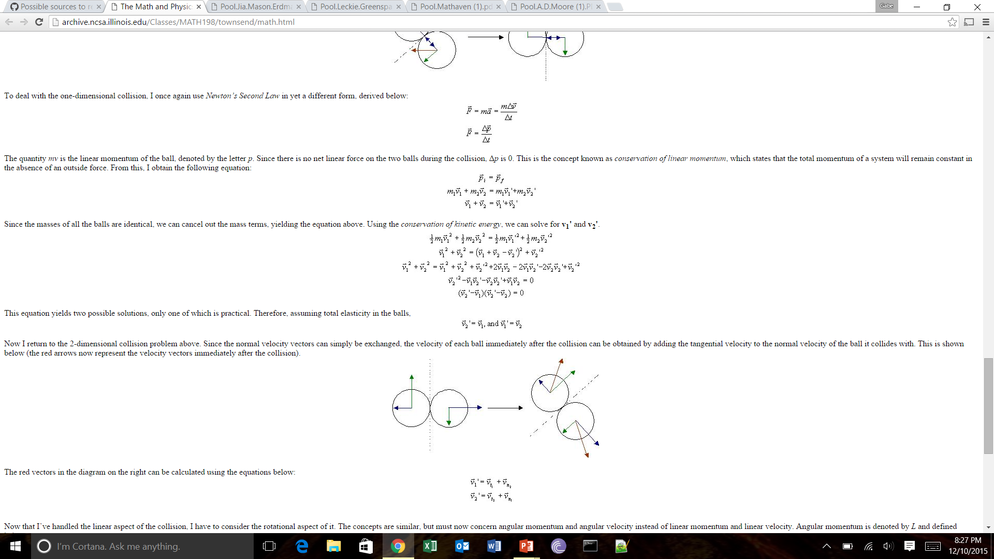

Ball-ball collisions
Using conservation of momentum and kinetic energy, we can find the velocities of two balls after they collide with one another
Here we assume that the collisions are completely elastic due to difficulties in implementing spin transfer
Balls will swap normal velocities but maintain their tangential velocities

Slide 8
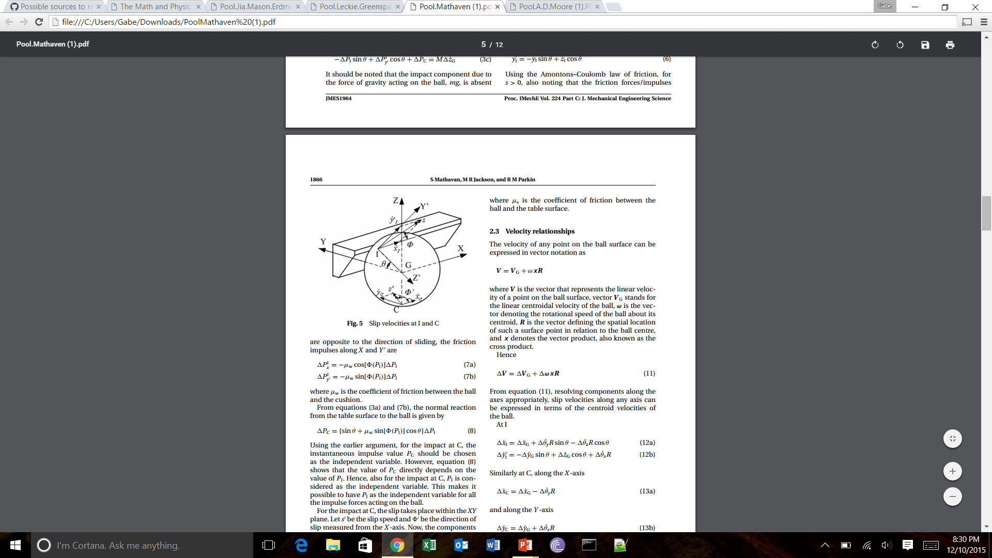
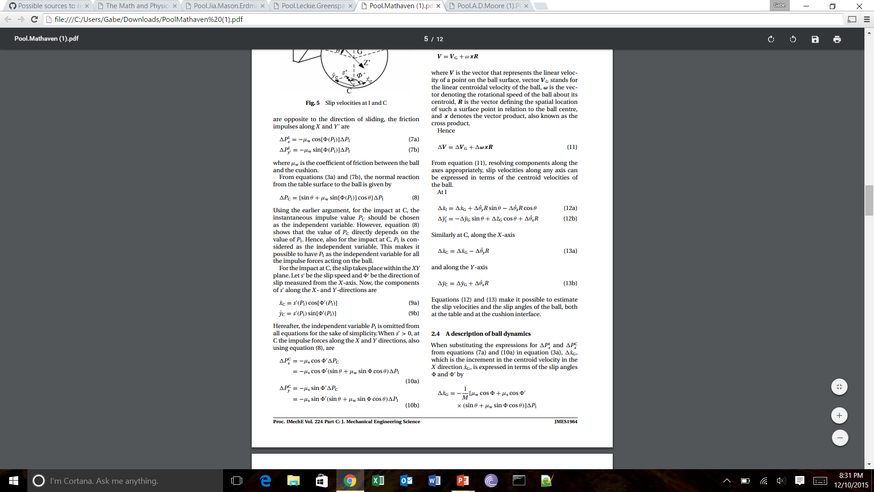
Ball-wall collisions
With ball-wall collisions we do not assume completely elastic collisions
We can calculate the x and y components of the impulse force between the ball and wall and use that to redefine velocities and positions.

Slide 9
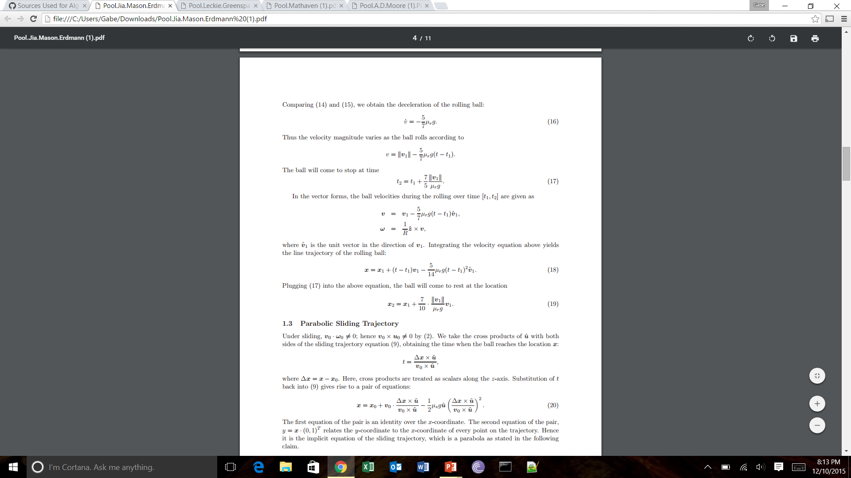
Final position
Iterating until a given time will continue to update the position and velocity vectors of the two pool balls until they come to rest at final spots on table

Slide 10
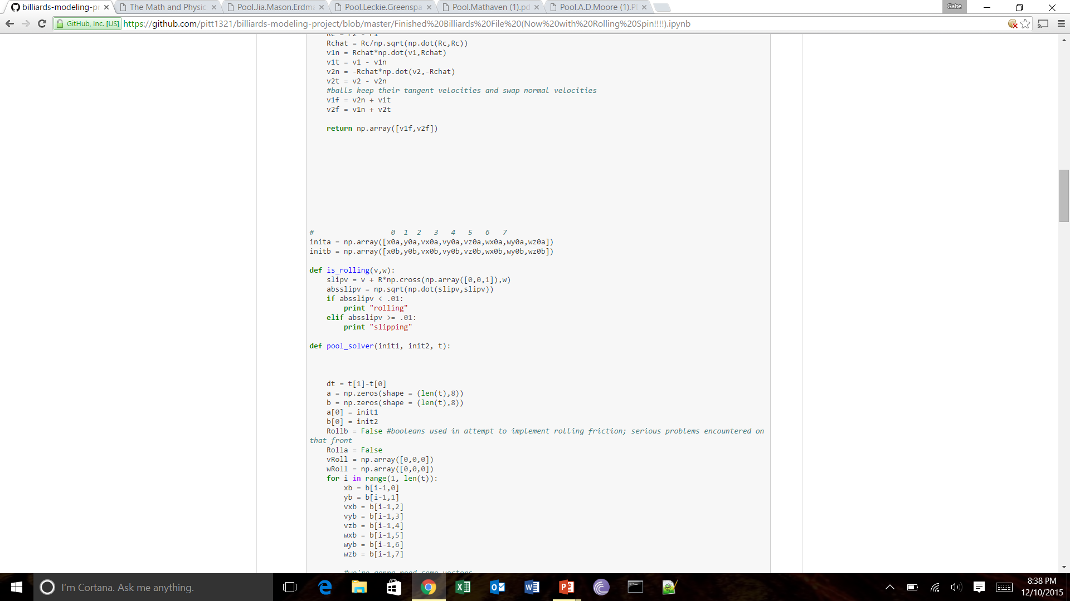
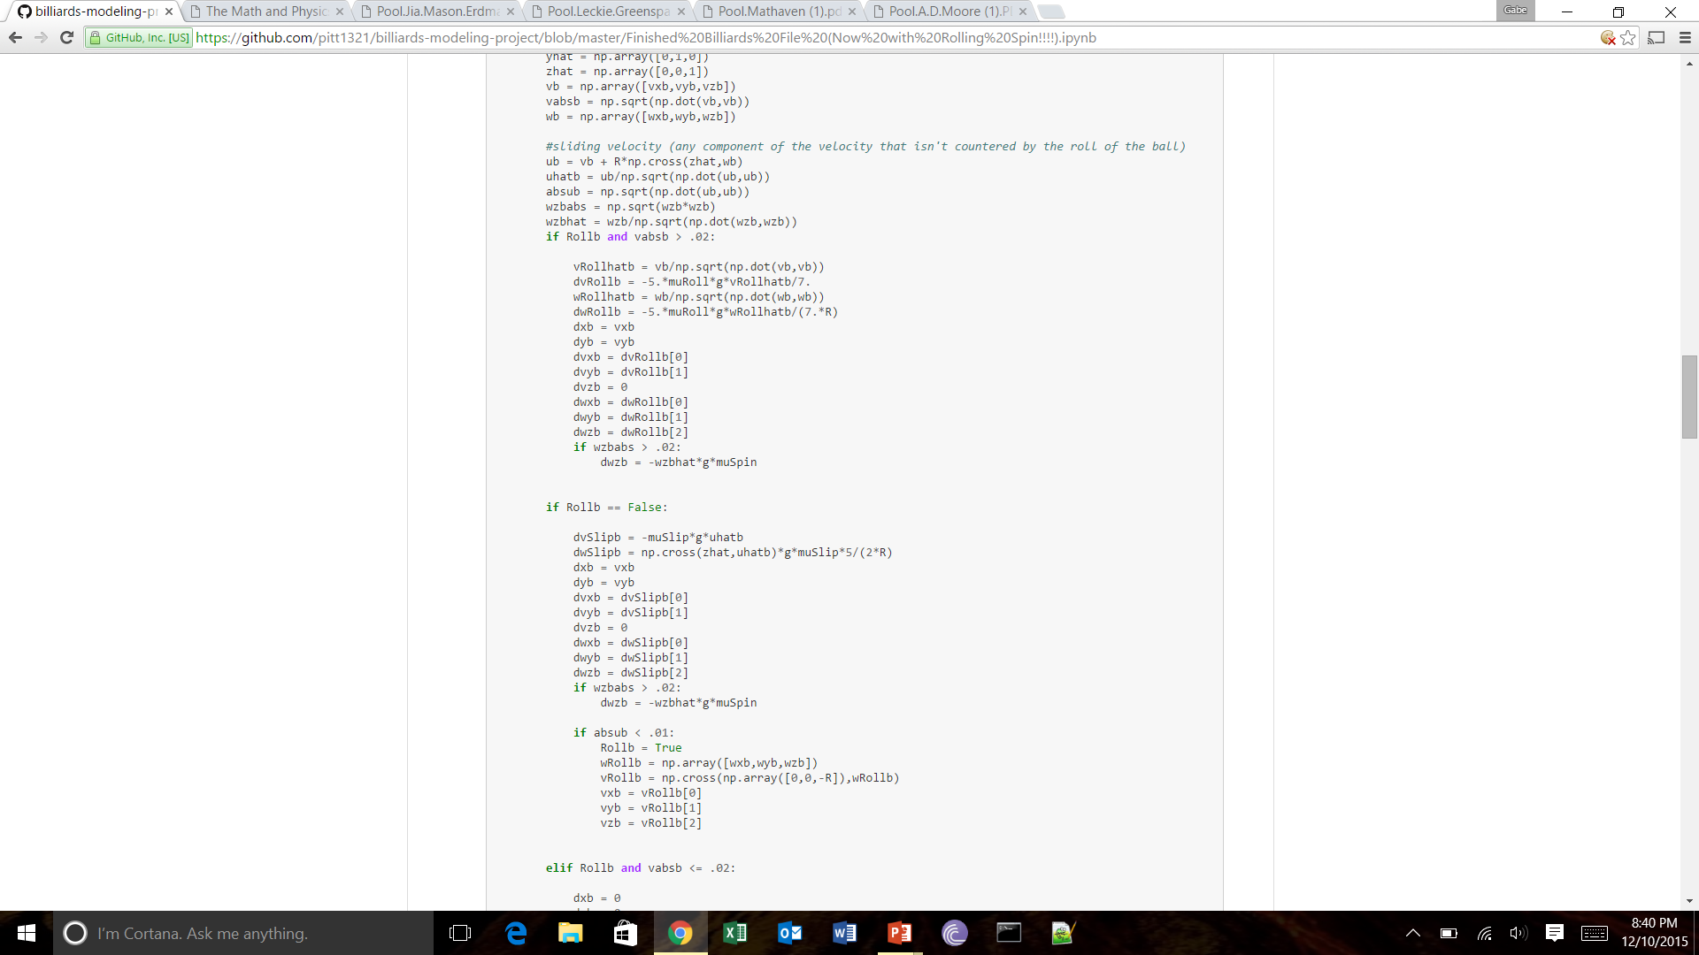
Solving the problem-friction

Slide 11
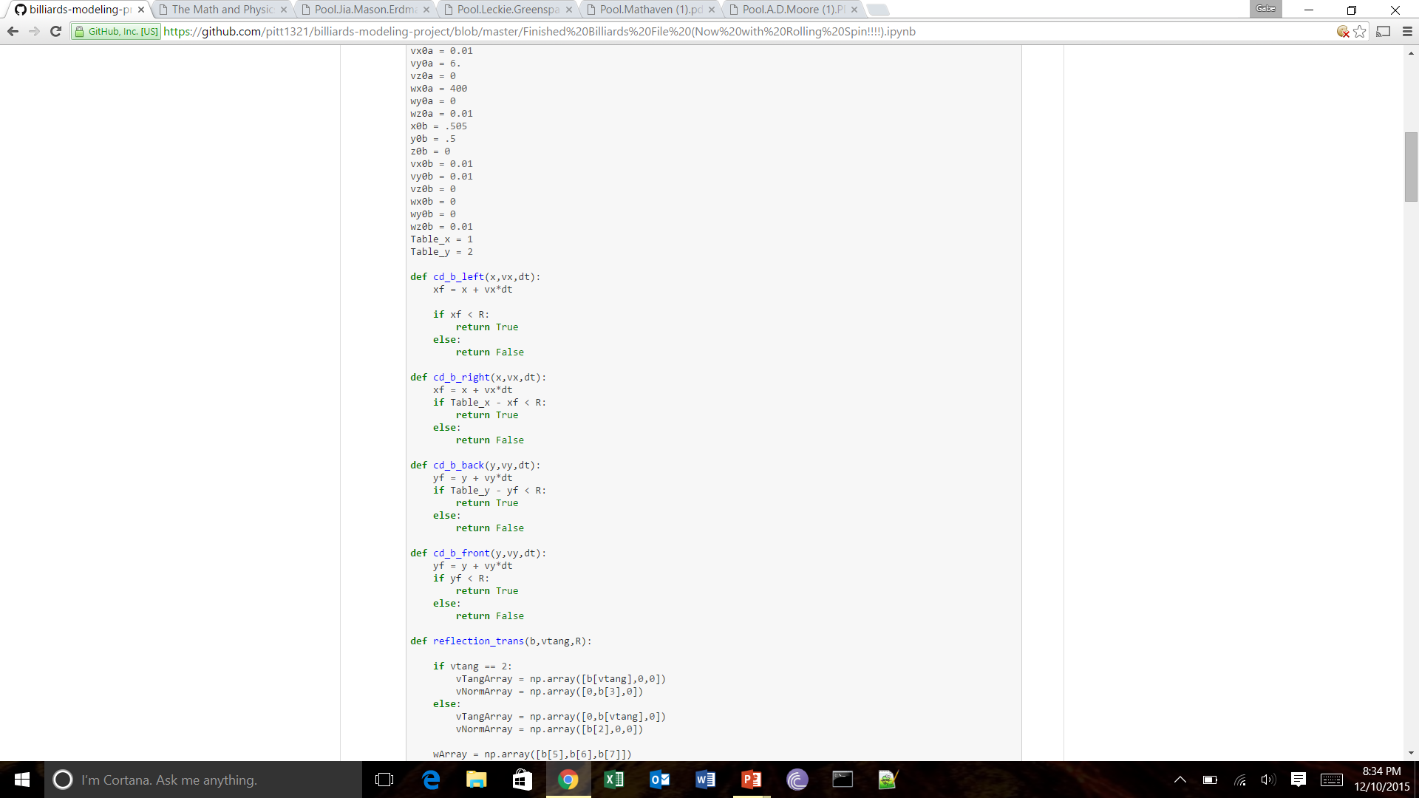
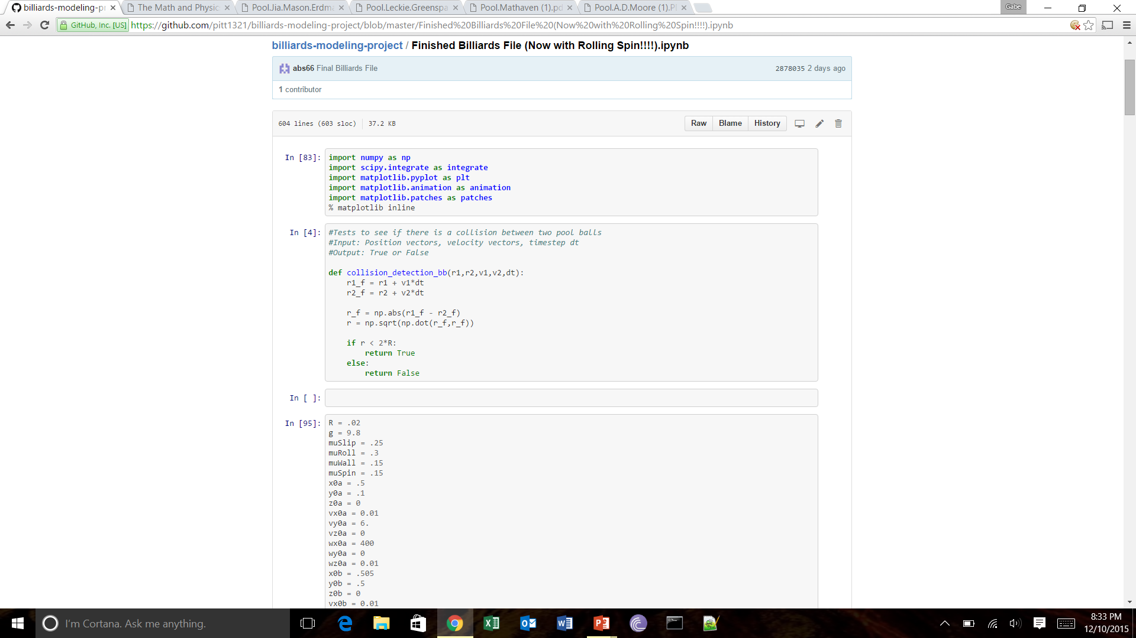
Solving the problem-collision detection

Slide 12
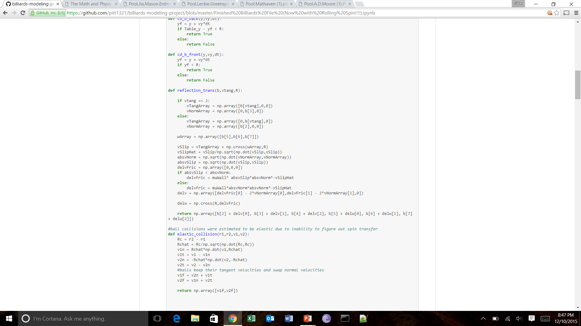
Solving the problem-collisions

Slide 13
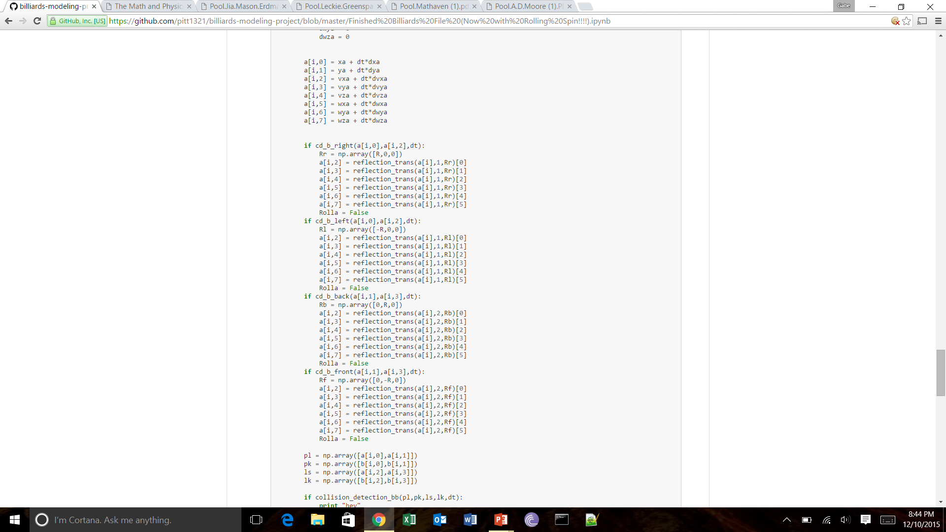
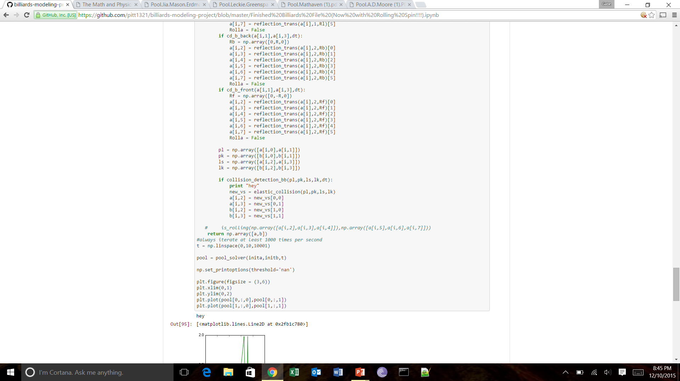
Solving the problem-final position

Slide 14
Initial conditions
The following initial conditions are the same for all trials
μ_{slip} = 0.25
μ_{roll} = 0.3
μ_{wall} = 0.15
μ_{spin} = 0.15
μ_{slip} = 0.02
g = 9.8

Slide 15
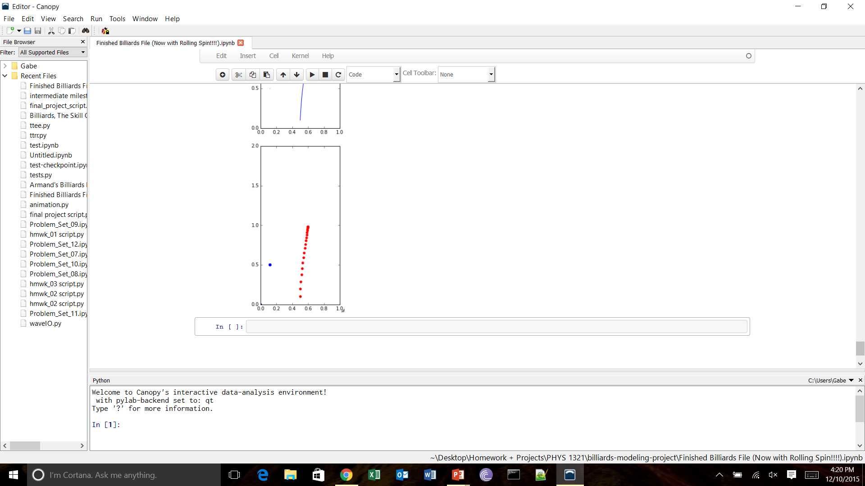
Results – sliding and rolling friction

Slide 16
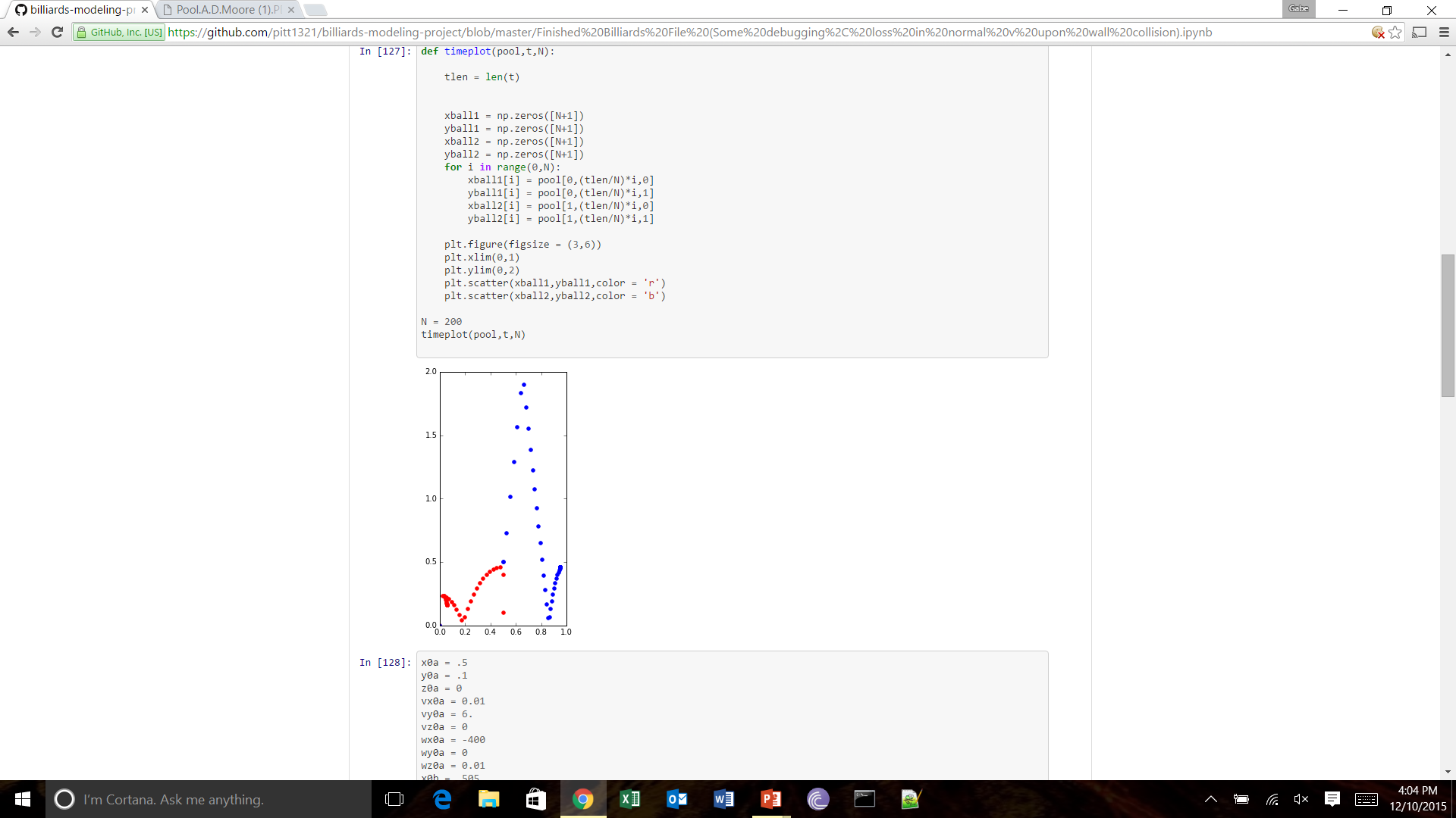
Results – Draw shot

Slide 17
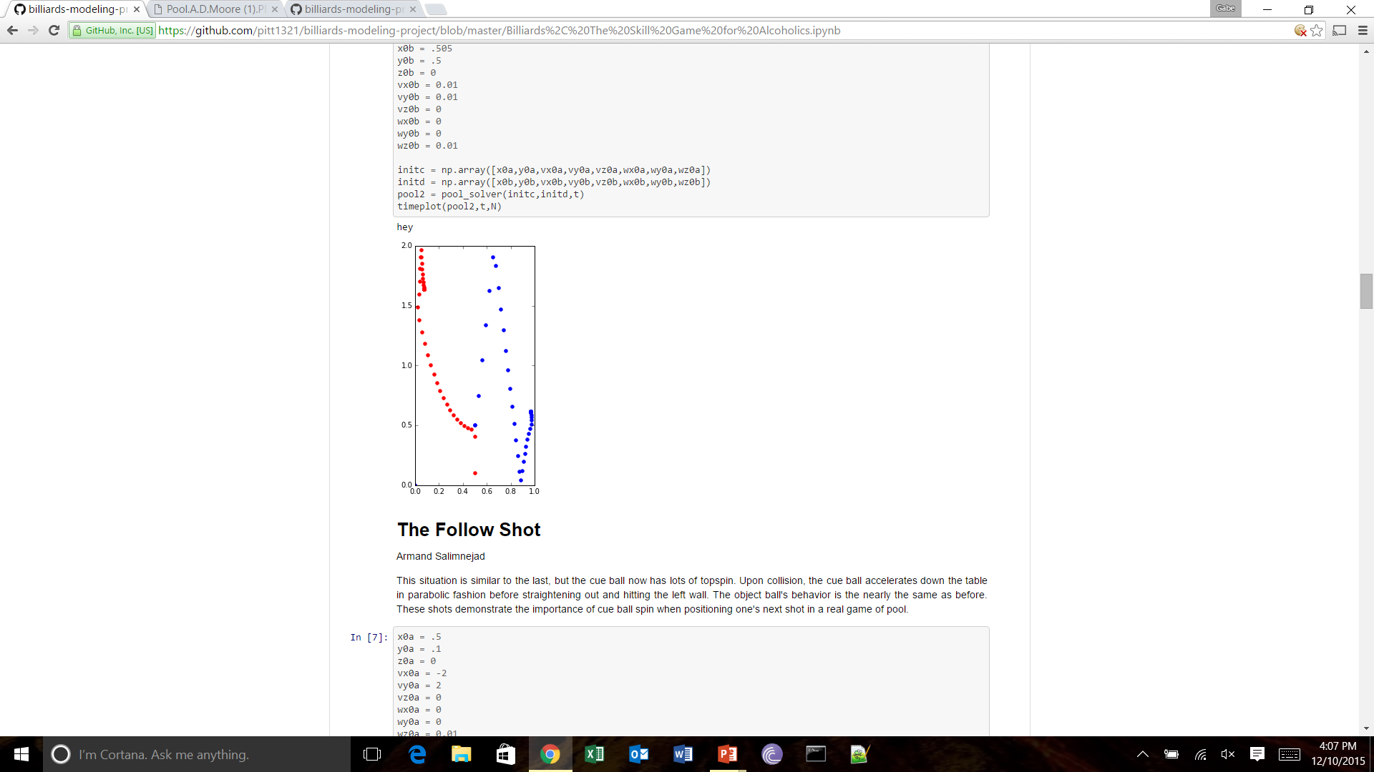
Results - follow shot

Slide 18
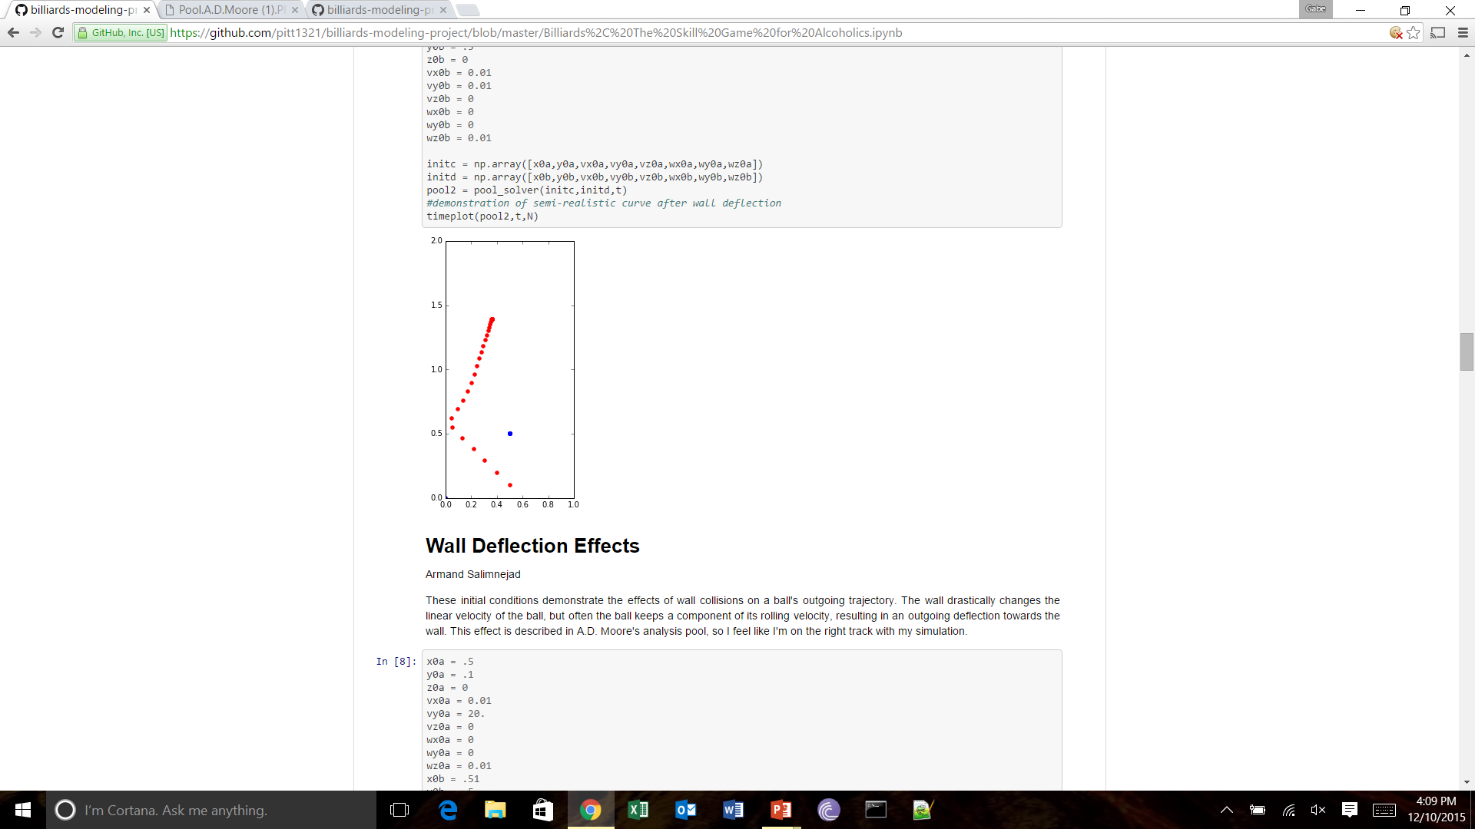
Results - wall deflection

Slide 19
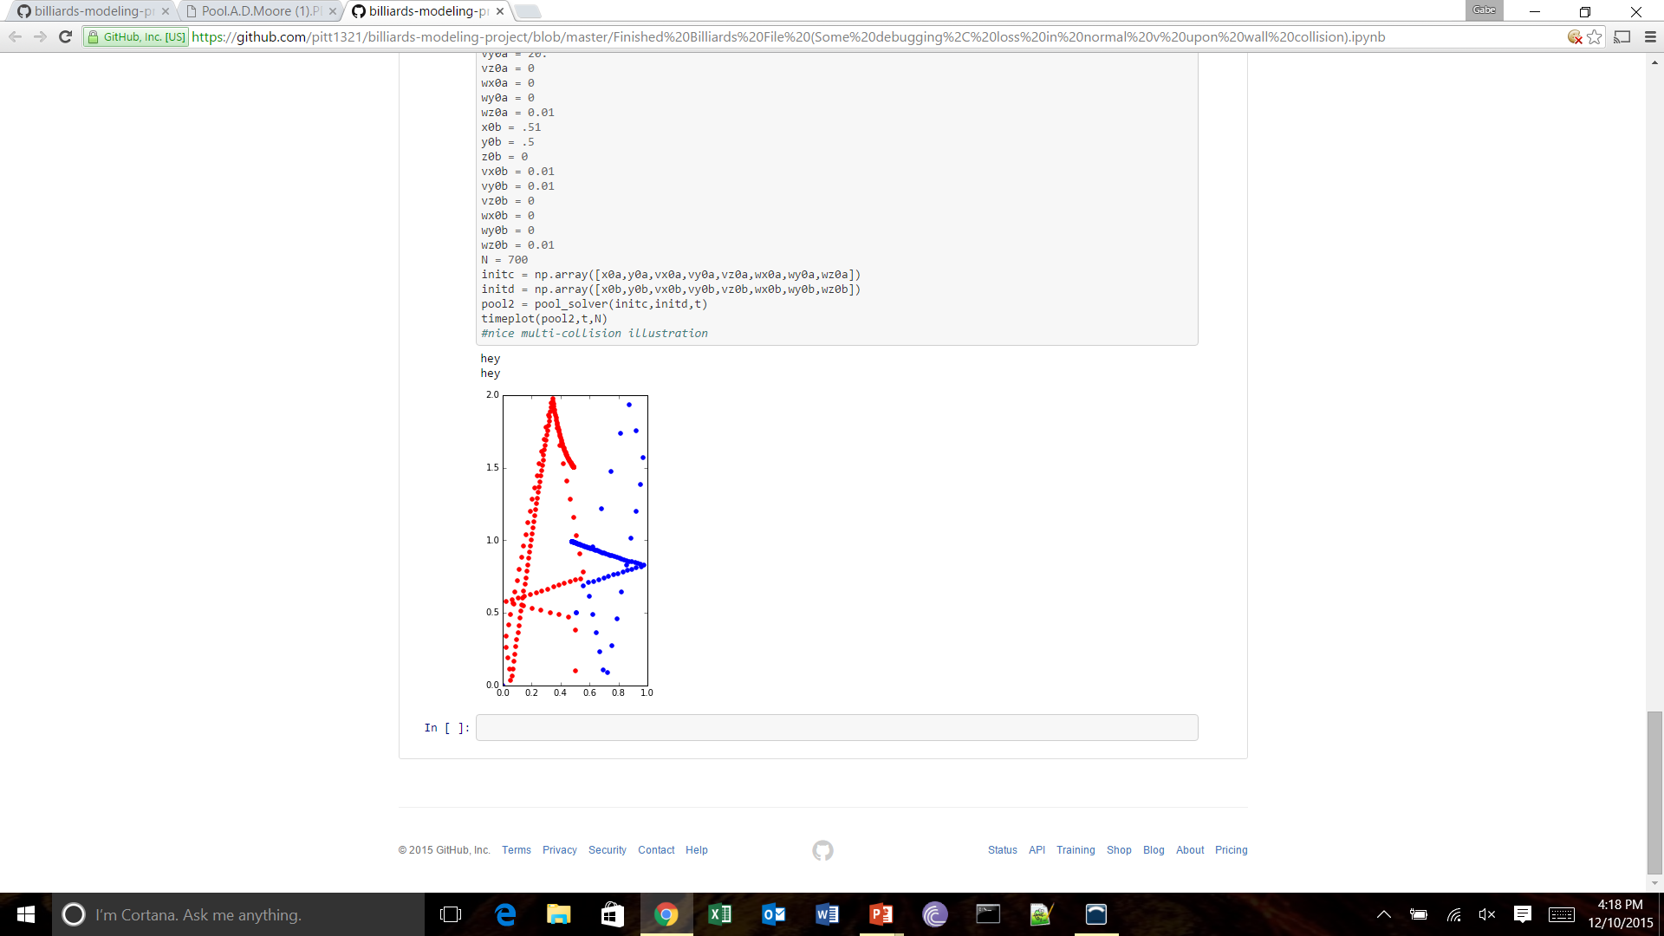
Results - multiple collisions

Slide 20
Future projects
Account for non-instantaneous collisions
Include more pool balls, up to 15 and the cue ball
Create the six pockets on the table for balls to fall into

